Slide 1
What is Python
Python is a strongly typed language.
In Python, Everything is an object.
Python’s type is checked at runtime not at compile time.
Python code is expressive and highly readable.
It does not require much complex coding due to rich libraries and huge support community.
Python comes pre-installed in ubuntu
To start in terminal → python3

Slide 2
Using the Python interactive Shell
To get the Python interactive interpreter type,
$ python
Python 2.7.12 (default, Nov 12 2018, 14:36:49)
[GCC 5.4.0 20160609] on linux2
Type "help", "copyright", "credits" or "license" for more information.
If you observe, we have the wrong Python version above, We wanted to use Python 3.x
Open a Terminal. Type in python and "Tab" key. You will see other installed versions, if there are any:
If no other Python version shows, python3.x has to be installed.
To start the python3 version, Type:
$ python3
Python 3.5.2 (default, Nov 12 2018, 13:43:14)
[GCC 5.4.0 20160609] on linux
Type "help", "copyright", "credits" or "license" for more information.
It's easy to end the interactive session: You can either use exit() or Ctrl-D

Slide 3
Read-Eval-Print-Loop(REPL)
The Shell as a Simple Calculator
2 * 2
4
x = 5
x
5
3 * x
15
_
15
_ * 2
30
_
30
print("Hello world")
Hello world

Slide 4
Running Python Script
Execute a Python script
Write a program which prints the string "Hello World". This looks on the Python shell like this:
print("Hello World!")
Hello World!
Write the script like below and Save it as my_first_simple_script.py
print("My first simple Python script!")
Start a Python script
python3 my_first_simple_script.py
My first simple Python script!
Python Internals
Python code is translated into intermediate code, which has to be executed by a virtual machine, known as the PVM, the Python virtual machine. This is a similar approach to Java. There is even a way of translating Python programs into Java byte code for the Java Virtual Machine (JVM). This can be achieved with Jython.

Slide 5
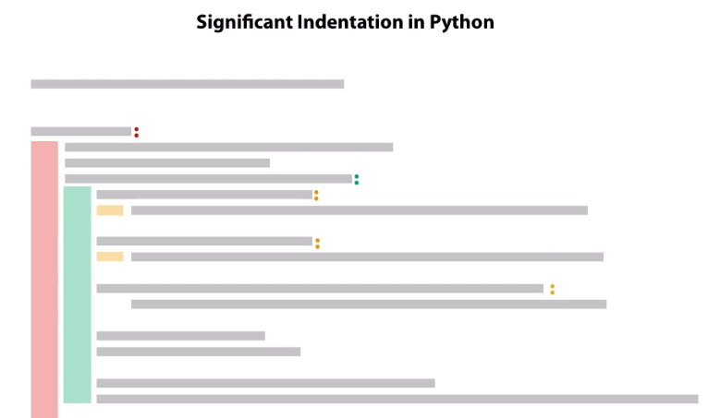
Significance of whitespace in python
Unlike other languages, Python uses indentation rather than braces for code blocks
By convention, Python uses four white spaces or tab, Four space is preferable and recommended over tab as per practice but never mix both tab and white space in your code.
For example, In REPL,
for i in range(3): # After colon Python expects the next line for code
... x = i * 10 #Before x , there are four white spaces.
... print(x) #there are four white spaces.
... #A blank line is needed to complete the code block and start execution in REPL
0
10
20

Slide 6
Python Standard Library
Import keyword can be used to use python modules.
For e.g. to import math module
import math
math.sqrt(81)
Note, the above helps to ignore new code implementation to find square root of any number by using method available in math module.
To know other methods available in a module in REPL, type help as below
help(math), Press q to exit help.
Suppose you are using any method repeatedly in your code from any module like below,
math.sqrt(81) * math.sqrt(4)
Instead we can import the method from module to increase code readability
from math import sqrt
sqrt(16) /sqrt(4)
from math import sqrt as find_square_root //Also can rename any method
find_square_root(16)

Slide 7
Variables
In general, A variable can be seen as a container to store certain values.
While the program is running, variables are accessed and sometimes changed, i.e. a new value will be assigned to a variable.
It's a lot easier in Python. There is no declaration of variables required in Python. It's not even possible. If there is need of a variable, think of any name and start using it as a variable.
Every instance (object or variable) has an identity, ID() function can be used to find the identity(memory reference) of any variable instance.
Note z = 20 also pointed to same reference as x and y, Python just points the variable to same memory reference, if the object is already available.
x = 20
id(x)
10919936
y = x
id(y)
10919936
y
20
x = "test"
id(x)
140269081556504
z = 20
id(z)
10919936

Slide 8
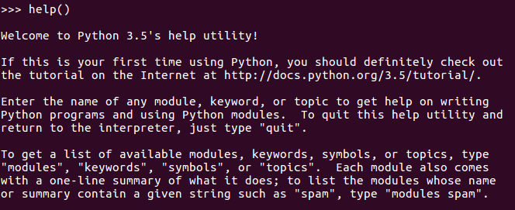
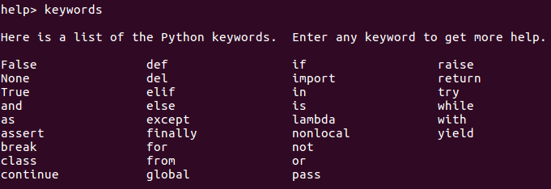
Help()
We can use python help() function to get much needed information's.
type in help() in the interactive, but please don't forget the parenthesis:

Slide 9
Datatype
Integers (e.g. 4321)
Integers in Python3 can be of unlimited size
Python 2 has two integer types: int and long. There is no "long int" in Python3 anymore. There is only one "int" type
There are two kinds of division operators for integers,
true division" performed by "/“
10 / 3
3.3333333333333335
10.0 / 3.0
3.3333333333333335
"floor division" performed by "//“
9 // 3
3
10 // 3
3
11 // 3
3
12 // 3
4

Slide 10


String
Tuple
Range
List
Dictionary
Set
Collections

Slide 11
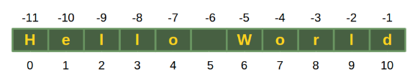
Strings
Strings - There are different ways to define strings in Python:
s = 'I am a string enclosed in single quotes.'
s2 = "I am another string, but I am enclosed in double quotes"
Single quotes will have to be escaped with a backslash (\), if the string is defined with single quotes:
s3 = 'It doesn\'t matter!'
s3 = "It doesn't matter!"
txt = "He said: \"It doesn't matter, if you enclose a string in single or double quotes!\""
print(txt)
Strings can be subscripted or indexed.
s = "Hello World"
s[0]
The last character of a string can be accessed like this:
s[len(s)-1]
The last character can be accessed with -1, the second to last with -2 and so on as well
s[-1]

Slide 12
String Memory
Strings show a special effect, which we will illustrate in the following example.
We will need the "is"-Operator.
If both a and b are strings, "a is b" checks if they have the same identity, i.e. share the same memory location.
If "a == b" has to be True means they both have similar value.
Note, if "a == b" True doesn't imply that "a is b" is True as well! But vice versa is true always.
a = "Linux"
b = "Linux"
a is b (True)
a == b (True)
But,
a = "Linux!"
b = "Linux!"
a is b (False) //The special character, i.e. the (!), is to "blame".
a == b (True)

Slide 13
Strings contd.
Immutable sequence of characters
a = 'sandeep'
len(a) # returns the length as 7
b = a + ' ' + 'Kumar' # Concatenate Strings
b #'sandeep Kumar'
a #'sandeep'
a += ", Pune" # Concatenate Strings, however creates a new object
a #'sandeep, Pune'
name = ';'.join(['sandeep','Kumar','Saurabh']) #Joins strings based on separator given.
name #'sandeep;Kumar;Saurabh'
name.split(';') #Devides on empty spaces by default
['sandeep', 'Kumar', 'Saurabh']
'unforgetable'.partition('forget') # Partition divides and results the string to tuples with three elements (suffix, separator, prefix)
('un', 'forget', 'able') # Tuple unpacking can be used here
"My name is {0}, I am from {1}".format("Sandeep","Pune")
'My name is Sandeep, I am from Pune'
"My name is {name}, I am from {place}".format(name = "Sandeep",place = "Pune") #Use of Format method
'My name is Sandeep, I am from Pune'

Slide 14
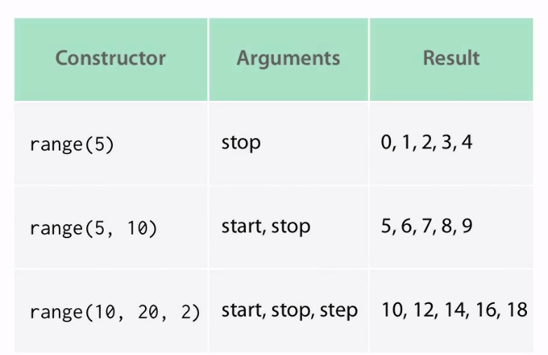
Range
Range is an arithmetic progression of integers
range(5)
range(0, 5)
for i in range(5):
... print(i)
...
range(12,20)
range(12, 20)
list(range(12,15))
[12, 13, 14]
list(range(10,25,3))
[10, 13, 16, 19, 22]
#Prefer enumerate over range for counters
a = ("sandeep","Saurabh","Ravi")
for i in enumerate(a):... print(i)
...
(0, 'sandeep')
(1, 'Saurabh')
(2, 'Ravi')

Slide 15
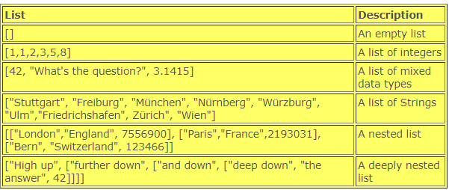
Lists
A list is an collection of objects.
To be more precise: A list in Python is an ordered group of items or elements.
It's important to notice that these list elements don't have to be of the same type and can be an arbitrary mixture of elements like numbers, strings, other lists and so on.
The main properties of Python lists:
They are ordered and mutable, i.e. the elements of a list can be changed
Elements of a list can be accessed by an index
They are arbitrarily nestable, i.e. they can contain other lists as sublists

Slide 16
Lists--Example
[1,2,3,4] #Create List
[1, 2, 3, 4]
a = [10,20,30] # Retrieve element from list
a[2]
30
a[2] = "Replaced" #Modify element of list
a
[10, 20, 'Replaced']
a.append("New Value") #Add a new element to list
a
[10, 20, 'Replaced', 'New Value']
a = list("test") //list constructor can be used as below.
a
['t', 'e', 's', 't']
# Negative index can be used for list to start from end
a = [10,20,30,40,50]
a[-1]
50
a[1:-1]
[20, 30, 40]
a[2:]
[30, 40, 50]
a[-2:]
[40, 50]
a[:-2]
[10, 20, 30]
b = a.copy()
[10, 20, 30, 40, 50]

Slide 17
Manipulate Lists
A list can be seen as a stack. A stack in computer science is a data structure, which has at least two operations: one which can be used to put or push data on the stack and another one to take away the most upper element of the stack.
Append - This method appends an element to the end of the.
lst = [3, 5, 7]
lst.append(42)
lst #[3, 5, 7, 42]
It's important to understand that append returns "None".
Pop - 'pop' returns the ith element of a list. The element will be removed from the list, raises an IndexError exception if the list is empty or the index is out of range.
cities = ["Hamburg", "Linz", "Salzburg", "Vienna"]
cities.pop(0) #('Hamburg‘)
cities
['Linz', 'Salzburg', 'Vienna']
cities = ["Amsterdam", "The Hague", "Strasbourg"]
cities.pop() #equivalent to s.pop(-1)
'Strasbourg'
cities
['Amsterdam', 'The Hague']

Slide 18
Removing an element with remove
Remove a certain value from a list without knowing the position.
This call will remove the first occurrence of element from the list, If element is not contained in the list, a ValueError will be raised.
colours = ["red", "green", "blue", "green", "yellow"]
colours.remove("green")
colours
['red', 'blue', 'green', 'yellow']
Find the Position of an Element in a List
The method "index" can be used to find the position of an element within a list
It returns the first index of the value x. A ValueError will be raised, if the value is not present.
If the start and stop index optional parameter i is given, the search will start and stop at given position.
colours = ["red", "green", "blue", "green", "yellow"]
colours.index("green")
1
colours.index("green", 2)
3
colours.index("green", 3,4)
3

Slide 19
Insert
We can put an element to the end of a list by using the method "append". But to add elements to arbitrary positions inside of a list, use insert()
lst = ["German is spoken", "in Germany,", "Austria", "Switzerland"]
lst.insert(3, "and")
lst
['German is spoken', 'in Germany,', 'Austria', 'and', 'Switzerland']
Count : Counts number of times element “10” in the list
colours = ["red", "green", "blue", "green", "yellow"]
colours.count("green")
2
Sort and reverse the elements of any list
colours.sort()
colours
['blue', 'green', 'green', 'red', 'yellow']
colours.reverse()
colours
['yellow', 'red', 'green', 'green', 'blue']

Slide 20
Tuple
A tuple (created using braces) is an immutable list means Once a tuple has been created, you can't add elements to a tuple or remove elements from a tuple.
Where is the benefit of tuples?
Tuples are faster than lists.
If you know that some data doesn't have to be changed, you should use tuples instead of lists, because this protects your data against accidental changes.
The main advantage of tuples consists in the fact that tuples can be used as keys in dictionaries, while lists can't.
a = ("sandeep", "Ravi", "Raj") // Create Tuple
a[1]
'Ravi'
len(a) //Find length of tuple
3
a * 2 //Repeat all elements twice in tuple
('sandeep', 'Ravi', 'Raj', 'sandeep', 'Ravi', 'Raj')
a,b = (10,20) //This is called tuple unpacking
a
10
b
20
tuple('test') //Use tuple constructor
('t', 'e', 's', 't')

Slide 21
Python - Dictionary
Dictionaries are key-value-pairs, create using curly braces {}
Dictionaries are unordered (don’t maintain any order of elements)
Dictionaries are implemented similar to hash tables in other languages.
city_population = {"New York City":8550405, "Los Angeles":3971883, "Toronto":2731571, "Chicago":2720546, "Houston":2296224, "Montreal":1704694, "Calgary":1239220, "Vancouver":631486, "Boston":667137}
city_population["New York City"]
8550405
city_population["Toronto"]
2731571
Note: if try to access a key, which is not contained in the dictionary, We get a KeyError.
city_population.keys()
dict_keys(['Houston', 'Calgary', 'New York City', 'Montreal', 'Vancouver', 'Los Angeles', 'Toronto', 'Chicago', 'Boston'])
city_population.values()
dict_values([2296224, 1239220, 8550405, 1704694, 631486, 3971883, 2731571, 2720546, 667137])

Slide 22
To add another entry to an existing dictionary:
city_population["Halifax"] = 390096
city_population
{'Toronto': 2615060, 'Ottawa': 883391, 'Los Angeles': 3792621, 'Chicago': 2695598, 'New York City': 8175133, 'Halifax': 390096, 'Boston': 62600, 'Washington': 632323, 'Montreal': 11854442}
Key value tuples in a list can be converted to dictionary as below.
a = [(1,20),(2,30),(3,40)]
b = dict(a)
b
{1: 20, 2: 30, 3: 40}
Removes the key with its value from the dictionary and returns the corresponding value, If the key is not found a KeyError is raised:
capitals = {"Austria":"Vienna", "Germany":"Berlin", "Netherlands":"Amsterdam"}
capital = capitals.pop("Austria")
print(capital)
Vienna
print(capitals)
{'Netherlands': 'Amsterdam', 'Germany': 'Berlin'}

Slide 23
A dictionary can be copied with the method copy():
a = {1:"cat",2:"Dog"}
b = a.copy()
a
{1: 'cat', 2: 'Dog'}
b
{1: 'cat', 2: 'Dog'}
a[1]="Tiger"
a
{1: 'Tiger', 2: 'Dog'}
b
{1: 'cat', 2: 'Dog'}
Update: Merging Dictionaries
update() merges the keys and values of one dictionary into another, overwriting values of the same key:
knowledge = {"Frank": {"Perl"}, "Monica":{"C","C++"}}
knowledge2 = {"Guido":{"Python"}, "Frank":{"Perl", "Python"}}
knowledge.update(knowledge2)
knowledge
{'Frank': {'Python', 'Perl'}, 'Guido': {'Python'}, 'Monica': {'C', 'C++'}}

Slide 24
Turn Lists into Dictionaries
dishes = ["pizza", "sauerkraut", "paella", "hamburger"]
countries = ["Italy", "Germany", "Spain", "USA"]
dict(zip(countries, dishes))
{'USA': 'hamburger', 'Germany': 'sauerkraut', 'Spain': 'paella', 'Italy': 'pizza'}
Lists from Dictionaries
w = {"house":"Haus", "cat":"", "red":"rot"}
items_view = w.items()
items = list(items_view)
items
[('house', 'Haus'), ('cat', ''), ('red', 'rot')]

Slide 25
Set
Unordered collection of unique and immutable objects means sets can't contain mutable objects but sets are mutable except frozensets.
Sets are often used for removing duplicates.
Elements can be added and remove from sets, however each element must be immutable.
This is also created using curly braces similar to dictionary but each element is a single object rather than a pair.
Also to create a set , we can use set constructor.
Set constructor also accepts iterable series of values like list etc.
a = {14,25,456,78,14}
a
{456, 78, 14, 25}
type(a)
<class 'set'>
a = [1,2,4,7,9,0,0]
set(a)
{0, 1, 2, 4, 7, 9}

Slide 26
If we want to create a set, we can call the built-in set function with a sequence or another iterable object:
In the following example, a string is singularized into its characters to build the resulting set x:
x = set("A Python Tutorial")
x
{'A', ' ', 'i', 'h', 'l', 'o', 'n', 'P', 'r', 'u', 't', 'a', 'y', 'T'}
type(x)
<class 'set'>
We can pass a list to the built-in set function, as we can see in the following:
x = set(["Perl", "Python", "Java"])
x
{'Python', 'Java', 'Perl'}
Immutable Sets
Sets are implemented in a way, which doesn't allow mutable objects. The following example demonstrates that we cannot include, for example, lists as elements:
cities = set((("Python","Perl"), ("Paris", "Berlin", "London")))
cities = set((["Python","Perl"], ["Paris", "Berlin", "London"]))
Traceback (most recent call last):
File "<stdin>", line 1, in <module>
TypeError: unhashable type: 'list'

Slide 27
Frozensets :
Though sets can't contain mutable objects, sets are mutable:
cities = set(["Frankfurt", "Basel","Freiburg"])
cities.add("Strasbourg")
cities
{'Freiburg', 'Basel', 'Frankfurt', 'Strasbourg'}
Frozensets are like sets except that they cannot be changed, i.e. they are immutable:
cities = frozenset(["Frankfurt", "Basel","Freiburg"])
cities.add("Strasbourg")
Traceback (most recent call last):
File "<stdin>", line 1, in <module>
AttributeError: 'frozenset' object has no attribute 'add'
add(element) : A method which adds an element, which has to be immutable, to a set.
colours = {"red","green"}
colours.add("yellow")
colours
{'green', 'yellow', 'red'}
Of course, an element will only be added, if it is not already contained in the set. If it is already contained, the method call has no effect.

Slide 28
clear() : All elements will be removed from a set.
cities = {"Stuttgart", "Konstanz", "Freiburg"}
cities.clear()
cities
set()
copy
Creates a shallow copy, which is returned.
more_cities = {"Winterthur","Schaffhausen","St. Gallen"}
cities_backup = more_cities.copy()
more_cities.clear()
cities_backup
{'St. Gallen', 'Winterthur', 'Schaffhausen'}
Just in case, you might think, an assignment might be enough:
more_cities = {"Winterthur","Schaffhausen","St. Gallen"}
cities_backup = more_cities
more_cities.clear()
cities_backup
set()
The assignment "cities_backup = more_cities" just creates a pointer, i.e. another name, to the same data structure.

Slide 29
difference() : This method returns the difference of two or more sets as a new set.
x = {"a","b","c","d","e"}
y = {"b","c"}
z = {"c","d"}
x.difference(y)
{'a', 'e', 'd'}
x.difference(y).difference(z)
{'a', 'e'}
difference_update() : The method difference_update removes all elements of another set from this set. x.difference_update(y) is the same as "x = x - y"
x = {"a","b","c","d","e"}
y = {"b","c"}
x.difference_update(y)
Instead of using the method difference, we can use the operator "-":
x - y
{'a', 'e', 'd'}
x - y - z
{'a', 'e'}

Slide 30
discard(element) : An element el will be removed from the set, if it is contained in the set. If el is not a member of the set, nothing will be done.
x = {"a","b","c","d","e"}
x.discard("a")
x
{'c', 'b', 'e', 'd'}
x.discard("z")
x
{'c', 'b', 'e', 'd'}
remove(element) : works like discard(), but if el is not a member of the set, a KeyError will be raised.
x = {"a","b","c","d","e"}
x.remove("a")
x
{'c', 'b', 'e', 'd'}
x.remove("z")
Traceback (most recent call last):
File "<stdin>", line 1, in <module>
KeyError: 'z'

Slide 31
union : This method returns the union of two sets as a new set, i.e. all elements that are in either set.
x = {"a","b","c","d","e"}
y = {"c","d","e","f","g"}
x.union(y)
{'d', 'a', 'g', 'c', 'f', 'b', 'e'}
This can be abbreviated with the pipe operator "|":
x | y
{'d', 'a', 'g', 'c', 'f', 'b', 'e'}
intersection : Returns the intersection of the instance set and the set s as a new set. In other words: A set with all the elements which are contained in both sets is returned.
x = {"a","b","c","d","e"}
y = {"c","d","e","f","g"}
x.intersection(y)
{'c', 'e', 'd'}
This can be abbreviated with the ampersand operator "&":
x & y
{'c', 'e', 'd'}

Slide 32
isdisjoint() : This method returns True if two sets have a null intersection.
x = {"a","b","c"}
y = {"c","d","e"}
x.isdisjoint(y)
False
x = {"a","b","c"}
y = {"d","e","f"}
x.isdisjoint(y)
True
issubset() : used to check if a set is a proper subset of a set.
x = {"a","b","c","d","e"}
y = {"c","d"}
x.issubset(y)
False
y.issubset(x)
True
x < y
False
y < x # y is a proper subset of x
True

Slide 33
issuperset() : used to check if a set is a proper superset of a set.
x = {"a","b","c","d","e"}
y = {"c","d"}
x.issuperset(y)
True
x > y
True
pop() : pop() removes and returns an arbitrary set element.
The method raises a KeyError if the set is empty
x = {"a","b","c","d","e"}
x.pop()
'a'
x.pop()
'c'

Slide 34
The input Function
If the input function is called, the program flow will be stopped until the user has given an input and has ended the input with the return key. The text of the optional parameter, i.e. the prompt, will be printed on the screen.
The input of the user will be returned as a string without any changes. If this raw input has to be transformed into another data type needed by the algorithm, we can use either a casting function or the eval function.
name = input("What's your name? ")
print("Nice to meet you " + name + "!")
age = input("Your age? ")
print("So, you are already " + age + " years old, " + name + "!")
We save the program as "input_test.py" and run it:
$ python input_test.py
What's your name? "Sandeep"
Nice to meet you Frank!
Your age? 40
So, you are already 40 years old, Sandeep!

Slide 35
Conditional Statement (IF Statement)
x = float(input("1st Number: "))
1st Number: 10
y = float(input("2nd Number: "))
2nd Number: 20
z = float(input("3rd Number: "))
3rd Number: 30
if x > y and x > z:
... maximum = x
... elif y > x and y > z:
... maximum = y
... else:
... maximum = z
...
print("The maximal value is: " + str(maximum))
The maximal value is: 30.0

Slide 36
While Loop
This example, take input from user and if the number entered by user is divisible by 7 then the loop breaks.
while True:
... response = input()
... if int(response) % 7 == 0:
... break
...
12
24
21
c = 5
while c != 0:
... print(c)
... c -= 1
...
5
4
3
2
1

Slide 37
For Loop
The Python for loop is an iterator based for loop. It steps through the items of lists, tuples, strings, the keys of dictionaries and other iterables. The Python for loop starts with the keyword "for" followed by an arbitrary variable name, which will hold the values of the following sequence object, which is stepped through.
a = [10,20,30]
for i in a:
... print(i)
...
10
20
30
a = { 1 : "Sandeep", 2 : "Saurabh", 3 : "Rohit"}
for i in a:
... print(i,a[i])
...
1 Sandeep
2 Saurabh
3 Rohit

Slide 38
Iterators and Iterables
The collection of elements are iterable (like lists, string etc) and An iterator can be seen as a pointer to a container, what we use to iterate through the elements of iterables.
You can iterate with a for loop over iterators and iterables.
list is iterable but a list is not an iterator!
Generators are a special kind of function, which enable us to implement or generate iterators. An iterator can be created from an iterable by using the function 'iter'.
For e.g., The for loop, this is how internally it works:
cities = ["Berlin", "Vienna", "Zurich"]
iterator_obj = iter(cities)
print(iterator_obj)
<list_iterator object at 0x7fc3ca292d68>
print(next(iterator_obj))
Berlin
print(next(iterator_obj))
Vienna
print(next(iterator_obj))
Zurich

Slide 39
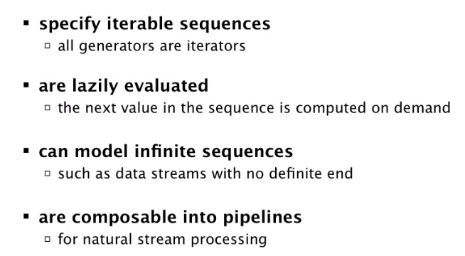
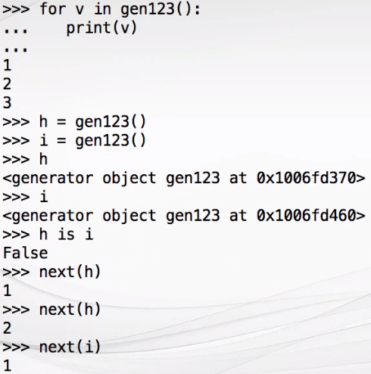
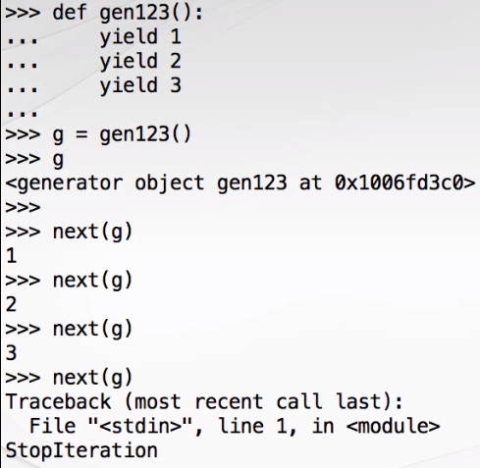
Generators in Python

Slide 40
Python - Function
A function in Python is defined by a def statement.
Sample method to find square.
def findsquare(x):
... return x*x
...
findsquare(4)
Another method to print hello
def sayHello():
... print("Hello")
...
sayHello( )
Hello
Find an input number is odd or even
def find_even_or_odd(x):
... if x % 2 == 0:
... print("Even")
... else:
... print('Odd')
...
find_even_or_odd(11)
Odd

Slide 41
Function to returns the temperature in degrees Fahrenheit
def fahrenheit(T_in_celsius):
... return (T_in_celsius * 9 / 5) + 32
...
for t in (22.6, 25.8, 27.3, 29.8):
... print(t, ": ", fahrenheit(t))
...
22.6 : 72.68
25.8 : 78.44
27.3 : 81.14
29.8 : 85.64
Optional Parameters : Functions can have optional/default parameters.
def Hello(name="everybody"):
... print("Hello " + name + "!")
Hello("Peter")
Hello Peter!
Hello()
Hello everybody!

Slide 42
Recursive Function in Python
Recursion is a method of programming or coding a problem, in which a function calls itself one or more times in its body. Usually, it is returning the return value of this function call.
If a function definition satisfies the condition of recursion, we call this function a recursive function.
Termination condition:
Once a recursive function fulfills an important condition to be used in a program: it has to terminate.
A recursive function terminates, if with every recursive call the solution of the problem is downsized and moves towards a base case.
A base case is a case, where the problem can be solved without further recursion. Note: A recursion can end up in an infinite loop, if the base case is not met in the calls.
def factorial(n):
... if n == 1:
... return 1
... else:
... return n * factorial(n-1)
...
print(factorial(5)) #120 (5 *4*3*2*1)

Slide 43
To track how the function works, add two print() functions to the previous function definition
def factorial(n):
print("factorial has been called with n = " + str(n))
if n == 1:
return 1
else:
res = n * factorial(n-1)
print("intermediate result for ", n, " * factorial(" ,n-1, "): ",res)
return res
print(factorial(5))
factorial has been called with n = 5
factorial has been called with n = 4
factorial has been called with n = 3
factorial has been called with n = 2
factorial has been called with n = 1
intermediate result for 2 * factorial( 1 ): 2
intermediate result for 3 * factorial( 2 ): 6
intermediate result for 4 * factorial( 3 ): 24
intermediate result for 5 * factorial( 4 ): 120
120

Slide 44
Exercise
Think of a recusive version of the function f(n) = 3 * n, i.e. the multiples of 3
Solution -1
def mult3(n):
if n == 1:
return 3
else:
return mult3(n-1) + 3
for i in range(1,10):
print(mult3(i))
Write a recursive Python function that returns the sum of the first n integers until it is zero.
Solution -2
def sum_n(n):
if n== 0:
return 0
else:
return n + sum_n(n-1)
print(sum_n(5))
15 (5+4+3+2+1)

Slide 45
Lambda (Anonymous Function)
The lambda operator or lambda function is a way to create small anonymous functions, i.e. functions without a name.
Lambda functions are throw-away functions, i.e. they are just needed where they have been created.
Lambda functions are mainly used in combination with the functions filter(), map() and reduce().
The following example of a lambda function returns the sum of its two arguments:
sum = lambda x, y : x + y
sum(3,4)
7
Another example
x = lambda a: a.split(",")[0]
x("hello,world")
'hello'

Slide 46
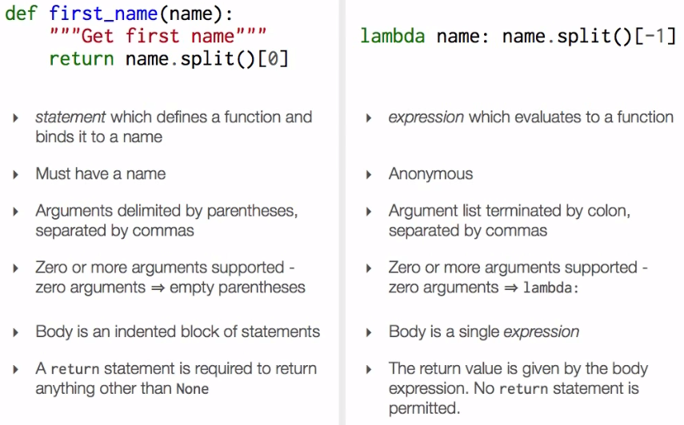
Named Function vs. Lambda

Slide 47
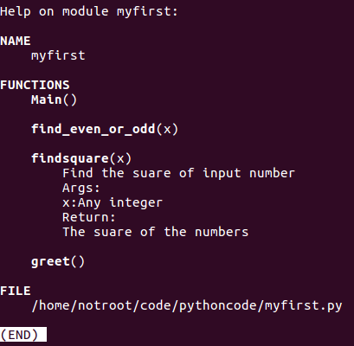
DocString
Documenting your code using DocStrings (i.e., using tripple quotes)
notroot@ubuntu:~/code/pythoncode$ python3
import myfirst
help(myfirst)
import sys
def findsquare(x):
''' Find the suare of input number
Args:
x:Any integer
Return:
The suare of the numbers
'''
return x*x
def Main():
a = sys.argv[1]
greet()
print(findsquare(int(a)))
if __name__ == '__main__':
Main()

Slide 48
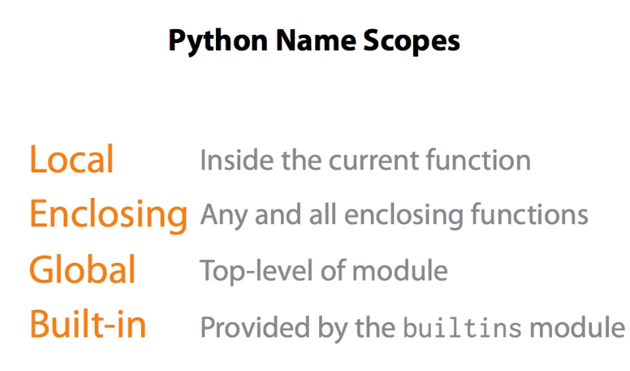

Slide 49
File Write/Append
Write to a File
f = open('sample.txt',mode='wt', encoding = 'utf-8') # wt-write text
f.write("test data ")
10
f.write(", Completed")
11
f.close() #Complete the file write
Append to a File
b = open('sample.txt',mode='at', encoding = 'utf-8') #at-append text
b.writelines(" \n, This time appending data to file, \n, also another line.")
b.close()

Slide 50
File Read
Get the system encode
import sys
sys.getdefaultencoding() #'utf-8'
Read data from a file.
The way of telling Python that we want to read from a file is to use the open function.
The first parameter is the name of the file we want to read. The second parameter, assigned to the value "r", we state that we want to read from the file:
a = open('sample.txt',mode='rt', encoding = 'utf-8') #rt- read text
a.read(21)
a.read(21)
#Need to again move to start of the file to read again using seek method()
a.seek(0) #moves the cursor to start of the file.
a.read() #'test data , Completed'
a.readline() #Read complete line
a.readlines() #Read all lines of a file

Slide 51
Python - Module
In Python module is every file, which has the file extension .py and consists of proper Python code.
The name of the module will be the name of the file.
A Python module can have a set of functions, classes or variables defined and implemented.
$ cd code/pythoncode/
~/code/pythoncode$ python3
import myfirst // Python interpreter searches the .py file in current directory.
myfirst.greet()
Hello...
myfirst.find_even_or_odd(14)
Even
from myfirst import findsquare # we can directly import methods from module
findsquare(5)
25
from myfirst import greet as greetings #Rename methods that is imported
greetings()
Hello...

Slide 52
__Main__()
If you want to execute your .py file
python3 myfirst.py
However you will not see any output as none of the functions are yet called for execution like default main method
To create a main method in python script file, Modify the file
sudo gedit myfirst.py
Add below lines to the code.
print(__name__) //This will print the default main method name and used here just for demo purpose.
if __name__ == '__main__':
greet();
Now execute, again
python3 myfirst.py
__main__
Hello...

Slide 53
Main()
The even better approach is creating a main() method and calling it like below.
import sys
def findsquare(x):
return x*x
def greet():
print("Hello...")
def find_even_or_odd(x):
if x % 2 == 0:
print("Even")
else:
print('Odd')
def Main():
a = sys.argv[1]
greet()
print(findsquare(int(a)))
if __name__ == '__main__':
Main()

Slide 54
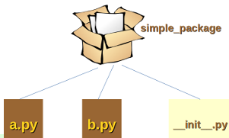
Package in Python
A package is basically a directory with Python files and a file with the name __init__.py and used to bundle multiple modules together to form a package. So every directory inside of the Python path, which contains a file named __init__.py, will be treated as a package by Python.
We can import the modules a and b in the following way:
import simple_package
Or
import simple_package.a
import simple_package.b
simple_package.a.bar()
simple_package.b.foo()

Slide 55
Exception Handling in Python
Exceptions handling in Python is similar to Java, However in Java exceptions are caught by catch clauses but in Python "except" keyword is used.
Example:
n = int(input("Please enter a number: ")) // Input will be a string, have to cast into an integer.
Please enter a number: 2.5
Traceback (most recent call last):
File "<stdin>", line 1, in <module>
ValueError: invalid literal for int() with base 10: '2.5'
Exception Handling:
while True:
try:
n = input("Please enter an integer: ")
n = int(n)
break
except ValueError:
print("Not a integer! Please enter again ...")

Slide 56
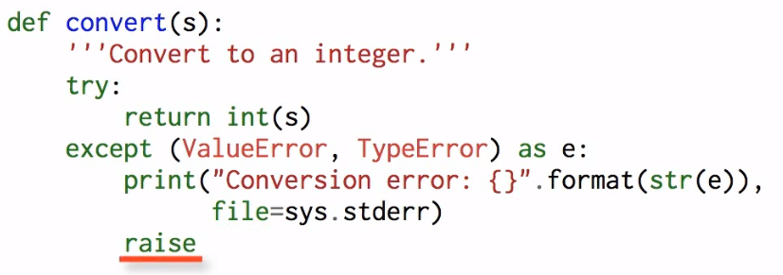
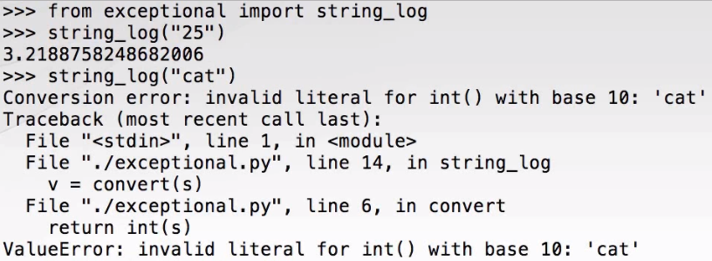
Re-raising Exception

Slide 57
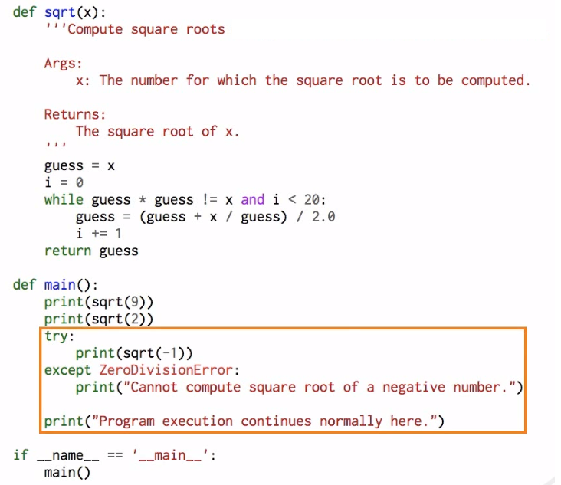
Another Exception example

Slide 58
Class and __init__() Method
Class keyword is used to define classes in python.
By convention, class name use camel casing.
Method is a function defined within a class
Instance Methods are functions which can be called on objects.
__init__ is a method which is immediately and automatically called after an instance of a class is created.
The __init__ method is used to initialize an instance. There is no explicit constructor or destructor method in Python, as they are known in C++ and Java.
The __init__ method can be anywhere in a class definition, but it is usually the first method of a class, i.e. it follows right after the class header.
class A:
def __init__(self):
print("__init__ has been executed!")
x = A()
__init__ has been executed!
Self is a key word, the first argument to all instance methods and is similar to this keyword in java or c++

Slide 59
Calling methods with Class Name
class myTest:
def greeting():
return "Hello-Nice Day"
myTest
<class '__main__.myTest'>
obj = myTest()
type(obj)
<class '__main__.myTest'>
myTest.greeting()
'Hello-Nice Day'
obj.greeting() #Note can’t call like this
Traceback (most recent call last):
File "<stdin>", line 1, in <module>
TypeError: greeting() takes 0 positional arguments but 1 was given
Note the keyword self which is required when methods are expected to call with class instance.

Slide 60
Calling class methods with instance
class myTest:
def greeting(self):
return "Hello-Nice Day"
myTest.greeting()
Traceback (most recent call last):
File "<stdin>", line 1, in <module>
TypeError: greeting() missing 1 required positional argument: 'self'
obj = myTest()
obj.greeting()
'Hello-Nice Day'
Note the keyword self which is required when methods are expected to call with class instance.

Slide 61
Inheritance
class Person:
... def __init__(self, first, last):
... self.firstname = first
... self.lastname = last
... def Name(self):
... return self.firstname + " " + self.lastname
...
class Employee(Person):
... def __init__(self, first, last, staffnum):
... Person.__init__(self,first, last)
... self.staffnumber = staffnum
... def GetEmployee(self):
... return self.Name() + ", " + self.staffnumber
...
x = Person("Sandeep", "Kumar")
y = Employee("Amit", "Saxena", "1009")
print(x.Name())
Sandeep Kumar
print(y.GetEmployee())
Amit Saxena, 1009

Slide 62
Polymorphism
Python is implicitly polymorphic. However to achieve the below in java we had to write many methods with specific type.
def f(x, y):
print("values: ", x, y)
f(42, 43)
f(42, 43.7)
f(42.3, 43)
f(42.0, 43.9)
In python we can set parameters to None, which makes it optional.
class Test:
def greetings(self, name=None):
if name is not None:
print('Hello ' + name)
else:
print('Hello ')
obj = Test()
obj.greetings()
obj.greetings('Sandeep')

Slide 63
Abstract Classes
Abstract classes are classes that contain one or more abstract methods.
An abstract method is a method that is declared, but contains no implementation.
Abstract classes may not be instantiated, and require subclasses to provide implementations for the abstract methods.
Python on its own doesn't provide abstract classes but comes with a module which provides the infrastructure for defining Abstract Base Classes (ABCs). This module is called - abc.
from abc import ABC, abstractmethod
A class that is derived from an abstract class cannot be instantiated unless all of its abstract methods are overridden.
Python pass Statement.
It is used when a statement is required syntactically but you do not want any command or code to execute. The pass statement is a null operation; nothing happens when it executes.

Slide 64
from abc import ABC, abstractmethod
class MyAbstractClass(ABC):
def __init__(self, value):
self.value = value
super().__init__()
@abstractmethod
def calculate(self):
pass
class DoAdd(MyAbstractClass):
def calculate(self):
return self.value + 40
class DoMul(MyAbstractClass):
def calculate(self):
return self.value * 40
x = DoAdd(10)
y = DoMul(5)
print(x.calculate())
print(y.calculate())

